Slide 1
TOTAL RECALL
Final Project of Digital Control
오유성 (22400448), 이주영 (22200576)
Thanks to
나원상
Won-Sang Ra

Slide 2
Digital Control and Signal Processing Final Project
1. Research background and goal
2. Motor Static Property
3. Motor Linearization
4. Obtain Bode plot
5. Transfer function & Validation

Slide 3
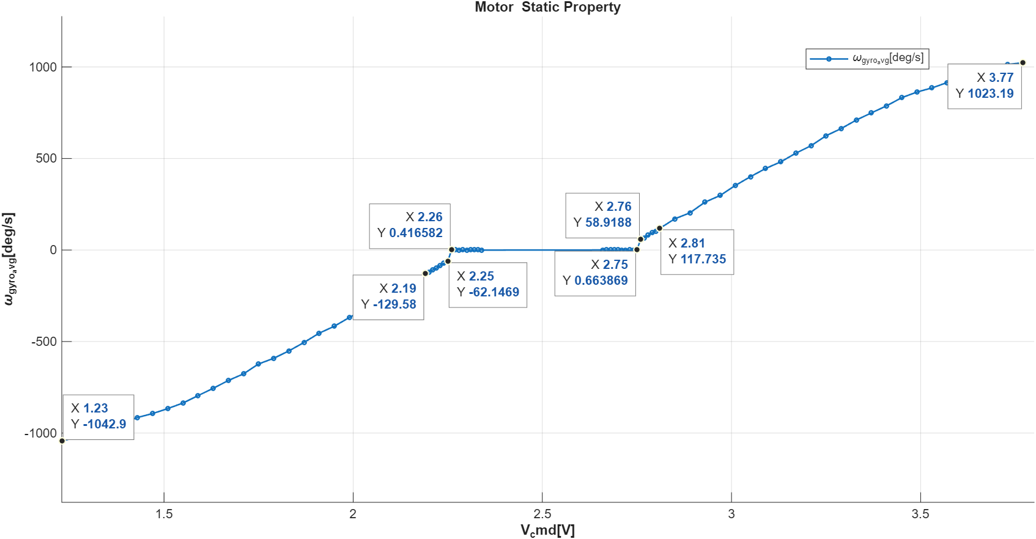

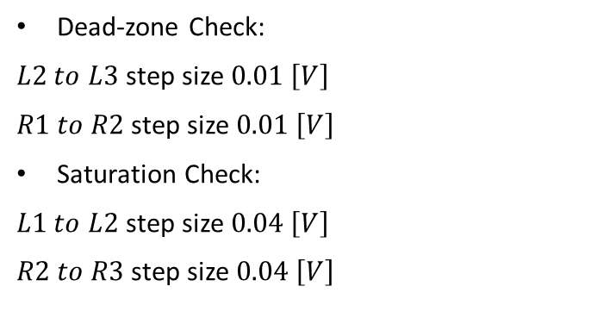
2. Motor Static Property
1) Check Deadzone, Saturation
R3
L3
R1
R2
L2
L1
Dead-zone Check:
$L2 to L3$ step size $0.01 \left[V\right]$
$R1 to R2$step size $0.01 \left[V\right]$
Saturation Check:
$L1 to L2$ step size $0.04 \left[V\right]$
$R2 to R3$step size $0.04 \left[V\right]$

Slide 4
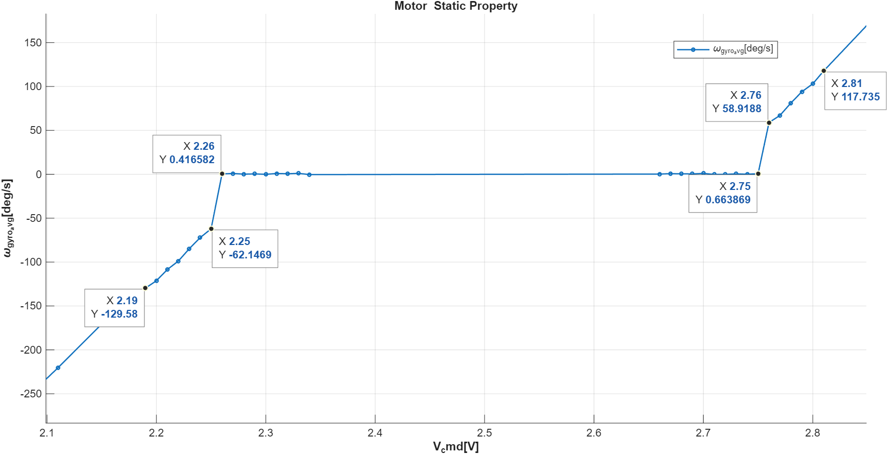
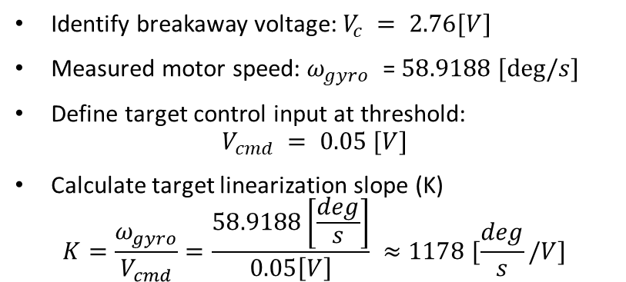
2. Motor Static Property
1) Check Deadzone, Saturation
2) Obtain Linearization Slope
R3
R2
L3
L2
R1
L1
Dead-zone Check:
$L2 to L3$ step size $0.01 \left[V\right]$
$R1 to R2$step size $0.01 \left[V\right]$
Saturation Check:
$L1 to L2$ step size $0.04 \left[V\right]$
$R2 to R3$step size $0.04 \left[V\right]$
Identify breakaway voltage: $V_{c} = 2.76[V]$
Measured motor speed:$ω_{gyro}$ = $58.9188 [deg/s]$
Define target control input at threshold:
$$V_{cmd} = 0.05 [V]$$
Calculate target linearization slope (K)
$$K=\frac{ω_{gyro}}{V_{cmd}}=\frac{58.9188\left[\frac{deg}{s}\right]}{0.05\left[V\right]} ≈1178 [\frac{deg}{s}/V]$$

Slide 5
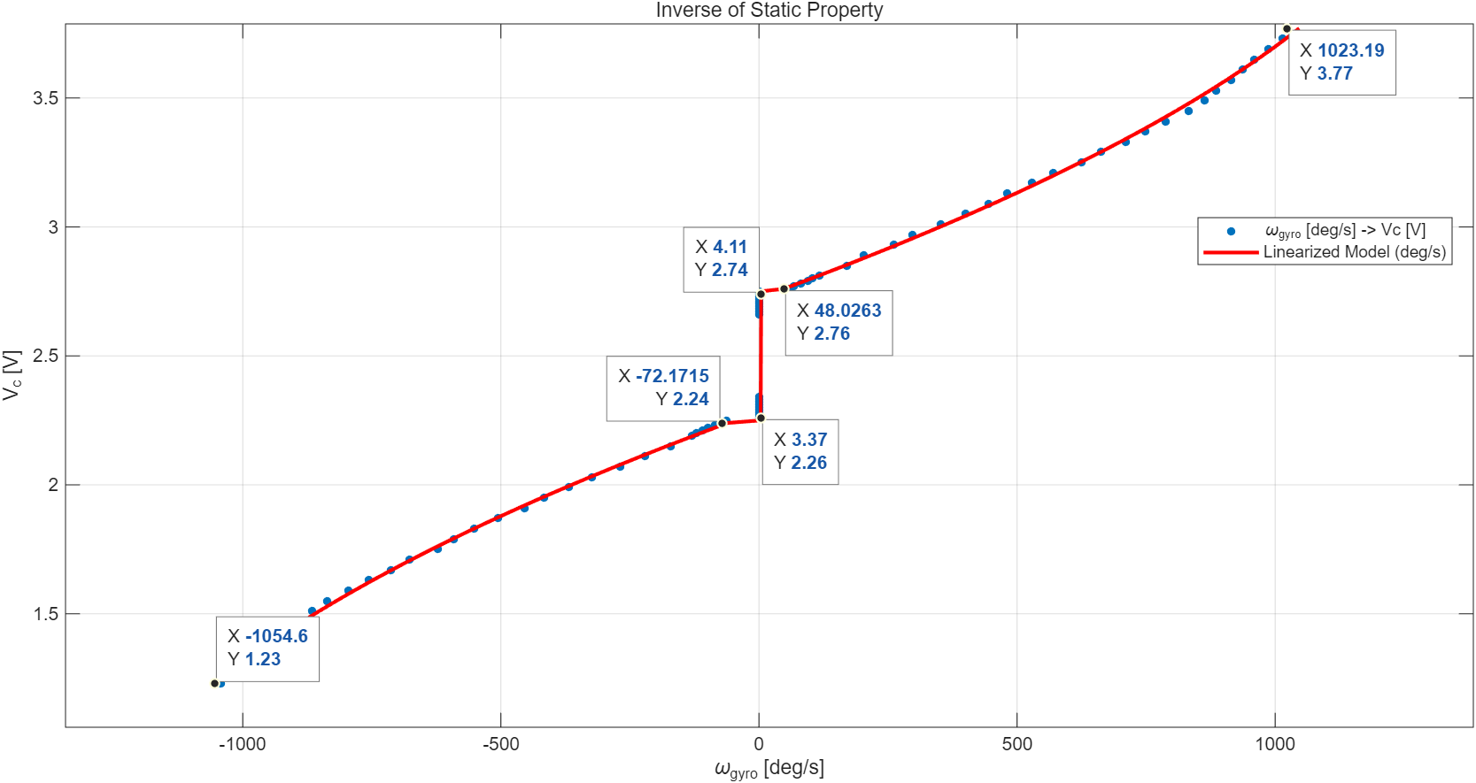
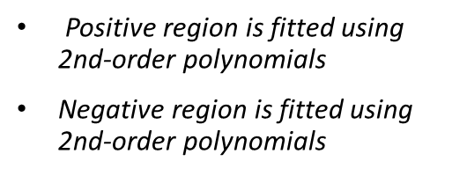
3. Motor Linearization
1) Inverse Function Modeling using 2nd-Order Polynomials
R3
R1
R2
L2
L1
L3
Positive region is fitted using 2nd-order polynomials
Negative region is fitted using 2nd-order polynomials

Slide 6
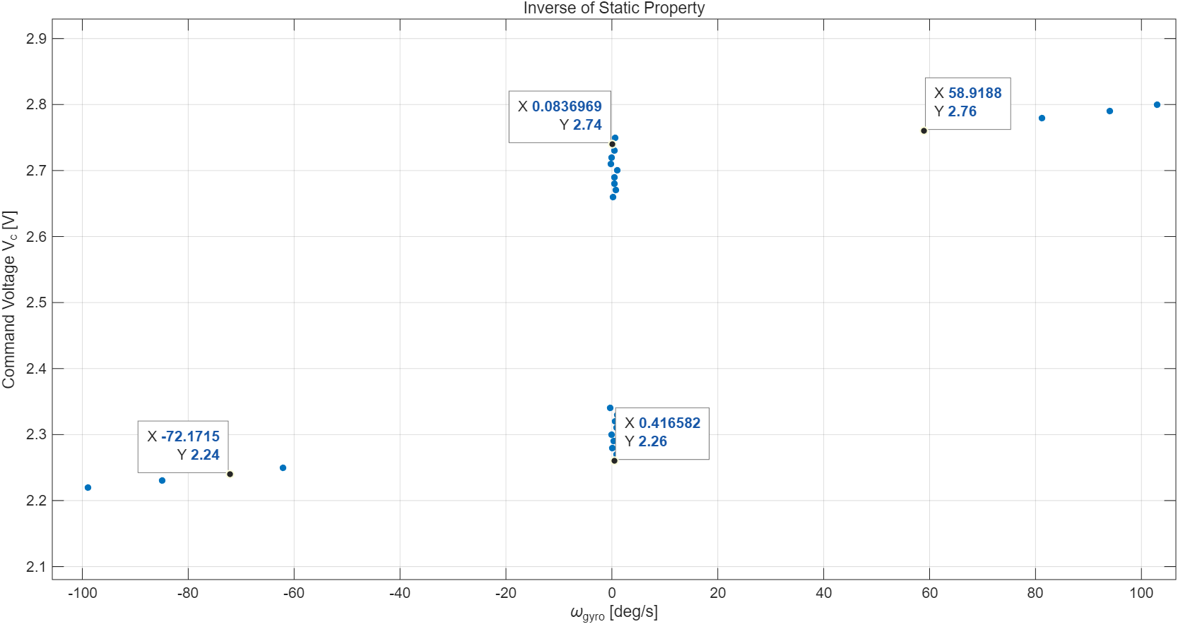

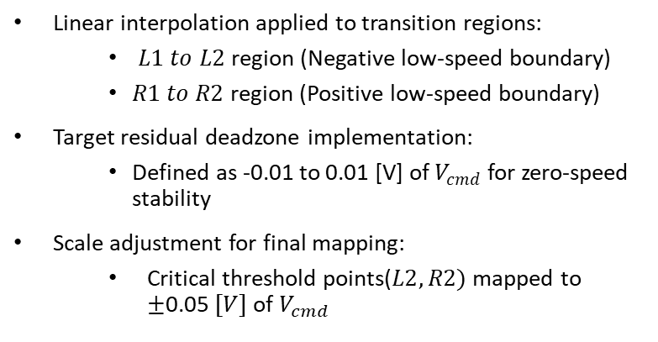
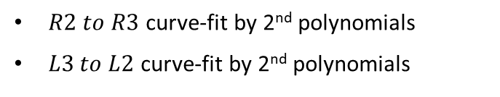

3. Motor Linearization
1) Inverse Function Modeling using 2nd-Order Polynomials
2) Dead-zone Handling & Mapped Linearization
Mapped $V_{cmd}=$-0.05 to 0.05
R1
R2
Mapped $V_{cmd}=$-0.01 to 0.01
L2
L1
$R2 to R3$ curve-fit by 2nd polynomials
$L3 to L2$ curve-fit by 2nd polynomials
Linear interpolation applied to transition regions:
$L1 to L2$region (Negative low-speed boundary)
$R1 to R2$region (Positive low-speed boundary)
Target residual deadzone implementation:
Defined as -0.01 to 0.01 [V] of $V_{cmd}$ for zero-speed stability
Scale adjustment for final mapping:
Critical threshold points($L2, R2)$ mapped to $±$0.05 $[V]$ of $V_{cmd}$

Slide 7
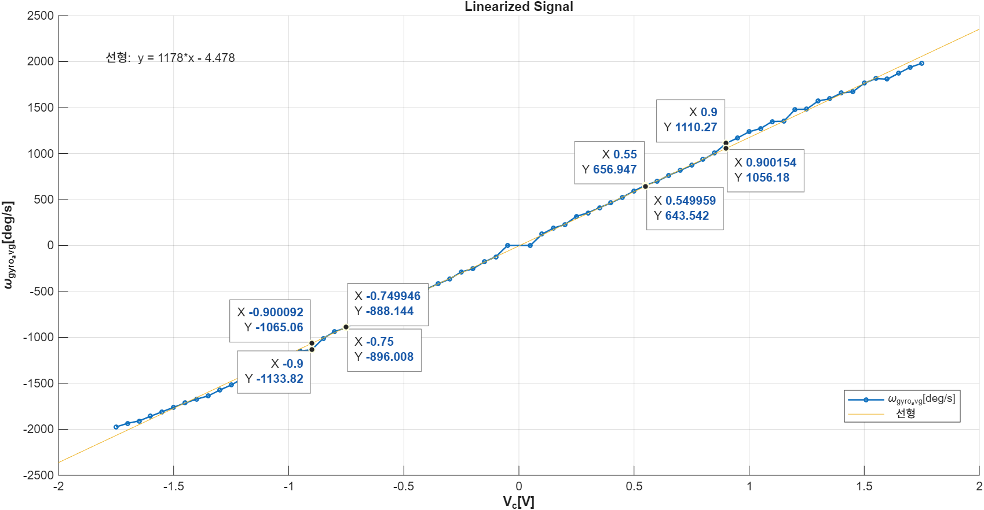
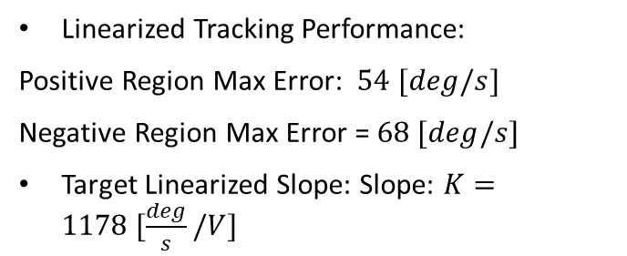
3. Motor Linearization
1) Linearized Static Property
Linearized Tracking Performance:
Positive Region Max Error: $54 [deg/s]$
Negative Region Max Error = $68 [deg/s]$
Target Linearized Slope: Slope: $K=1178 [\frac{deg}{s}/V]$

Slide 8
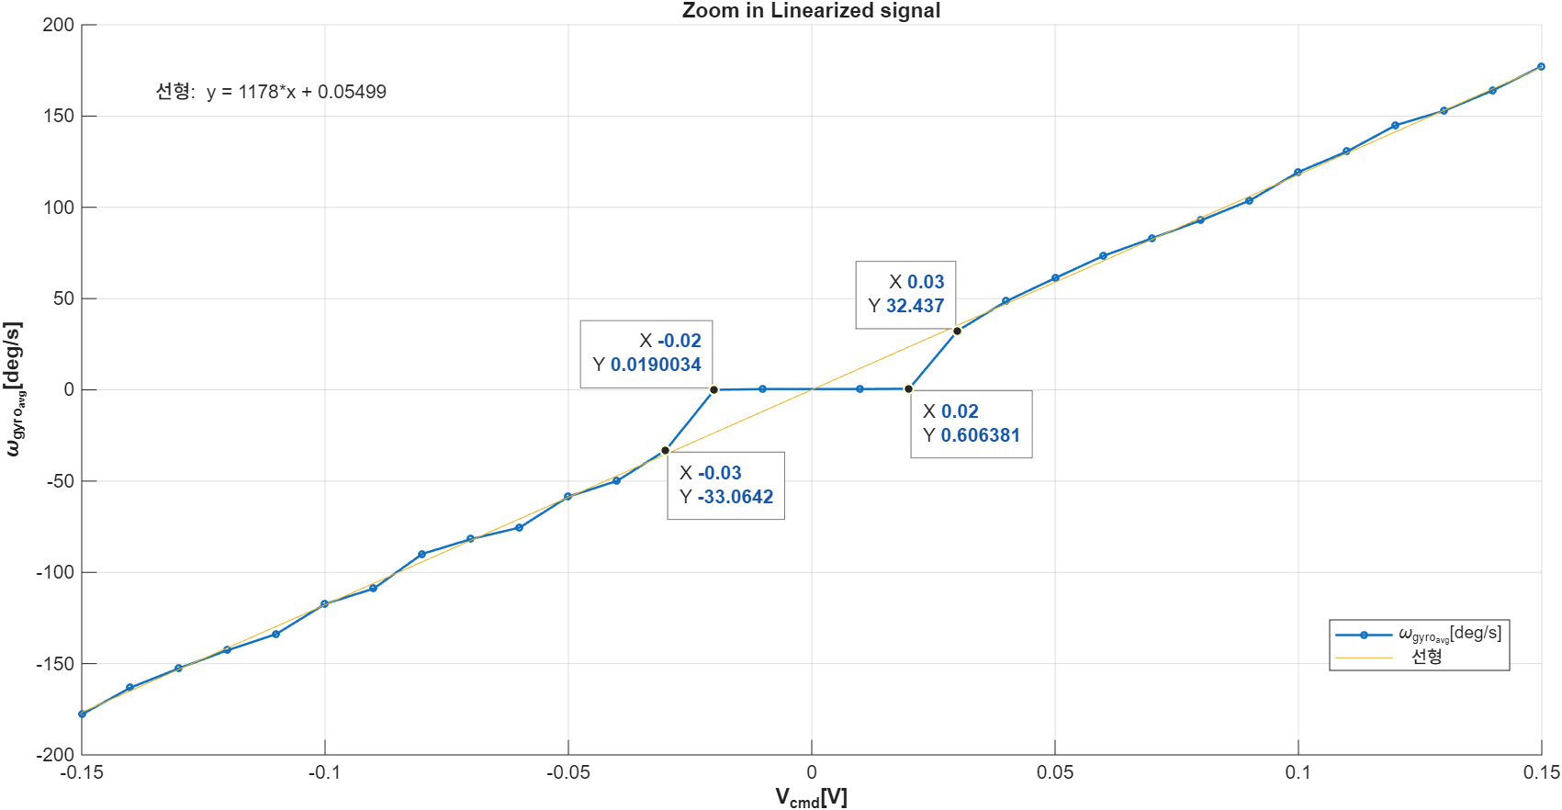
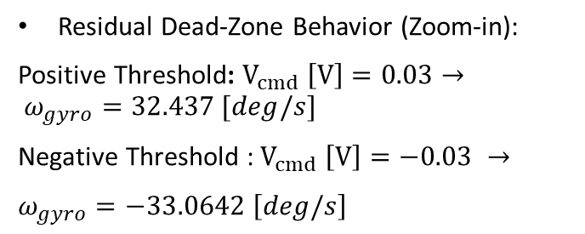
3. Motor Linearization
1) Linearized Static Property
Linearized Tracking Performance:
Positive Region Max Error: $54 [deg/s]$
Negative Region Max Error = $68 [deg/s]$
Target Linearized Slope: Slope: $K=1178 [\frac{deg}{s}/V]$
Residual Dead-Zone Behavior (Zoom-in):
Positive Threshold: $V_{cmd} \left[V\right]=0.03→ ω_{gyro}=32.437 [deg/s]$
Negative Threshold : $V_{cmd} \left[V\right]=−0.03 →$
$ω_{gyro}=−33.0642 \left[deg/s\right]$

Slide 9
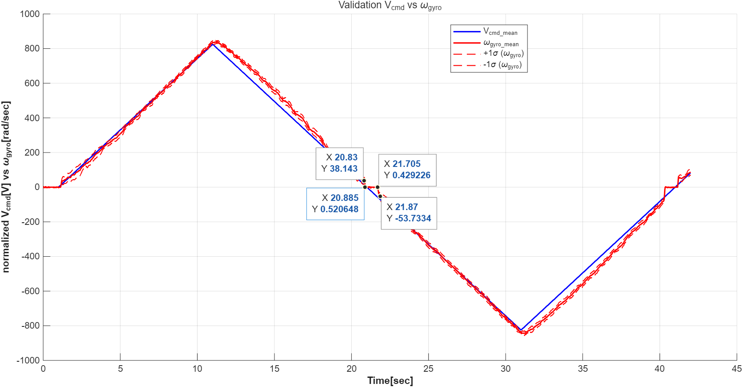
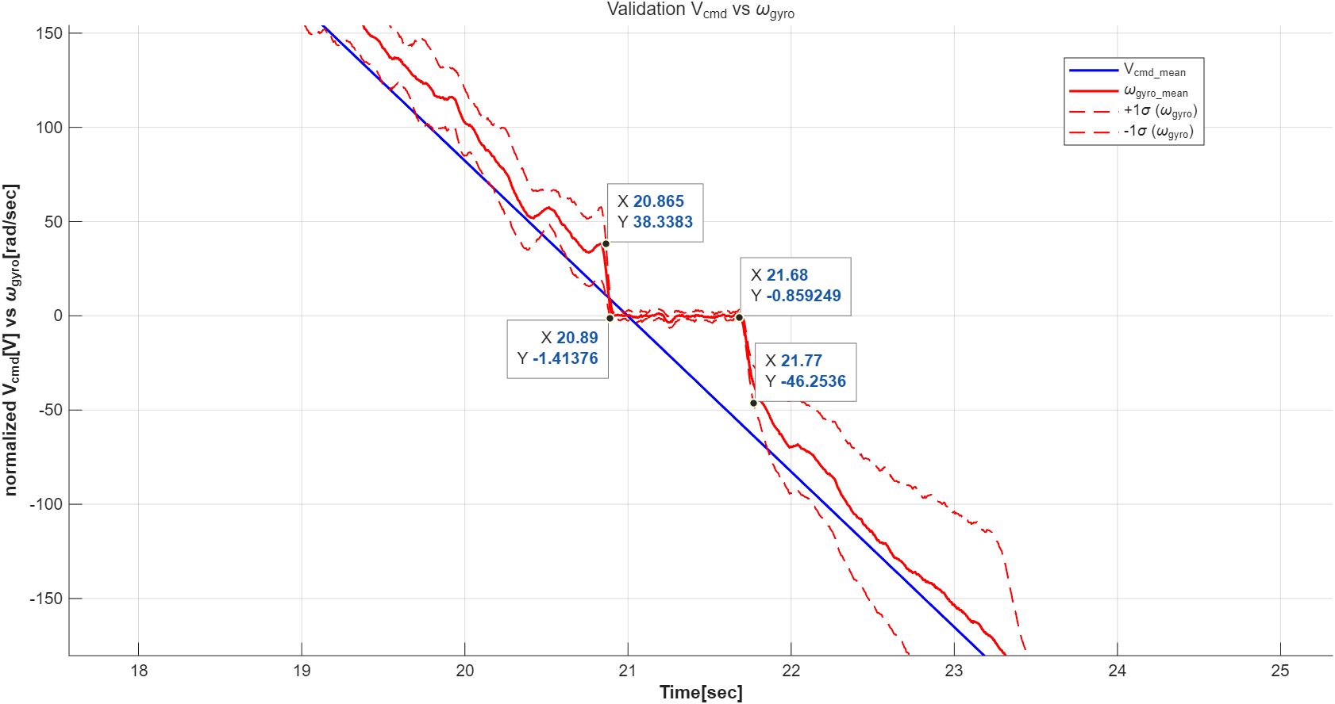
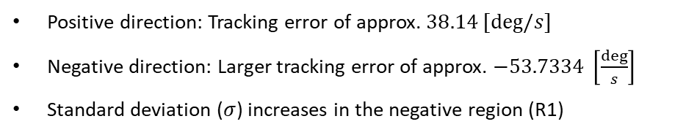
3. Motor Linearization Validation
1) Triangle input
R1
Positive direction: Tracking error of approx. $38.14 [deg/s]$
Negative direction: Larger tracking error of approx. $−53.7334 \left[\frac{deg}{s}\right]$
Standard deviation ($σ$) increases in the negative region (R1)

Slide 10
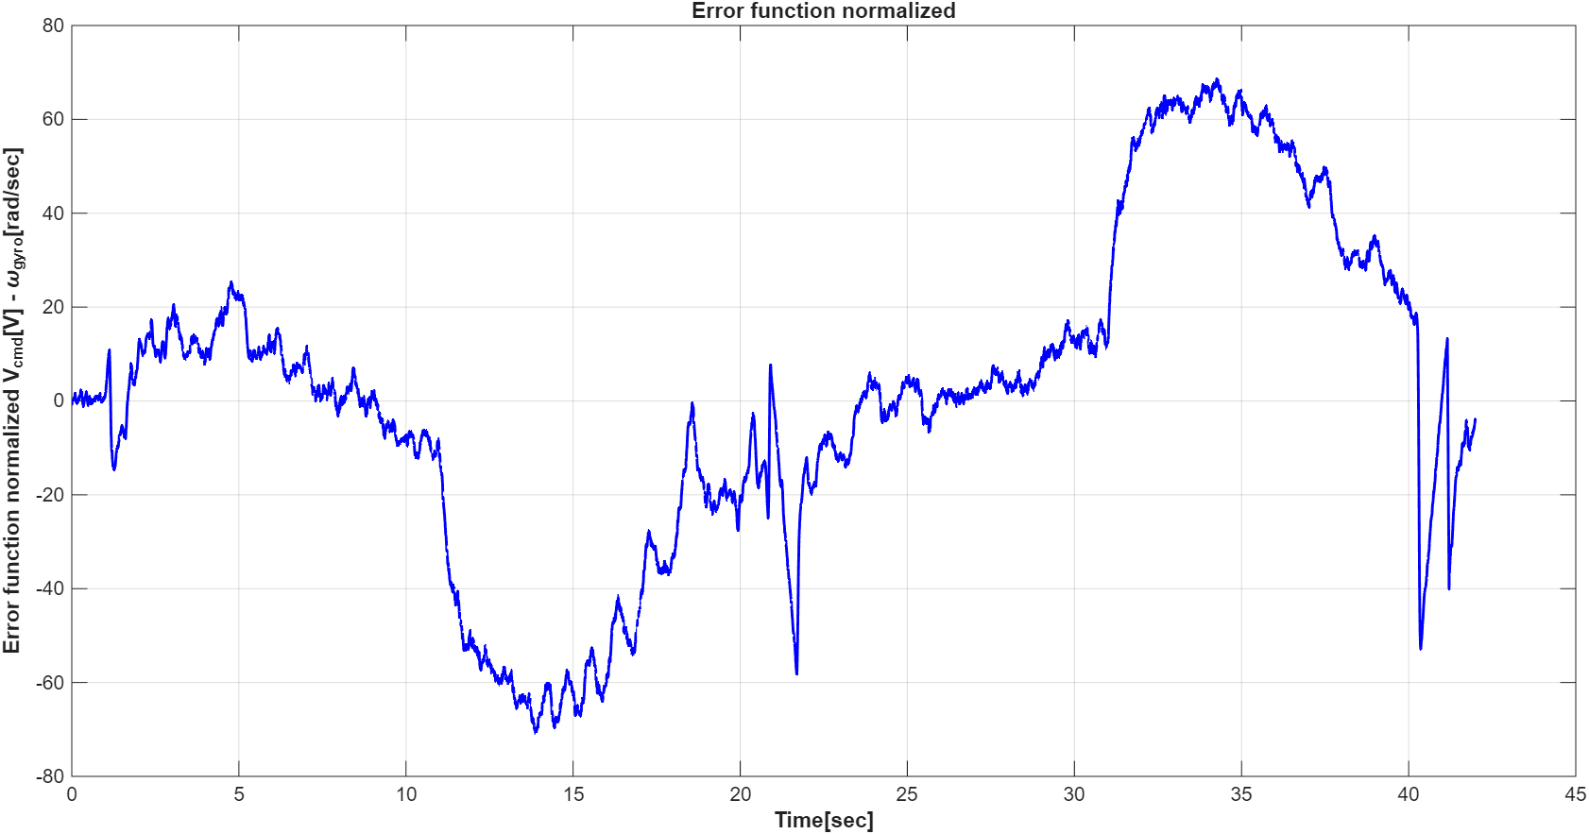
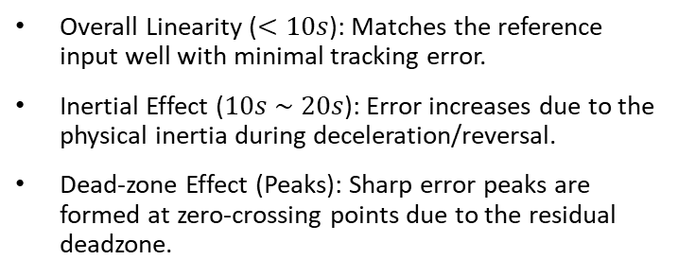
3. Motor Linearization Validation
1) Triangle input
R1
Overall Linearity ($<10s$): Matches the reference input well with minimal tracking error.
Inertial Effect ($10s \sim 20s$): Error increases due to the physical inertia during deceleration/reversal.
Dead-zone Effect (Peaks): Sharp error peaks are formed at zero-crossing points due to the residual deadzone.

Slide 11
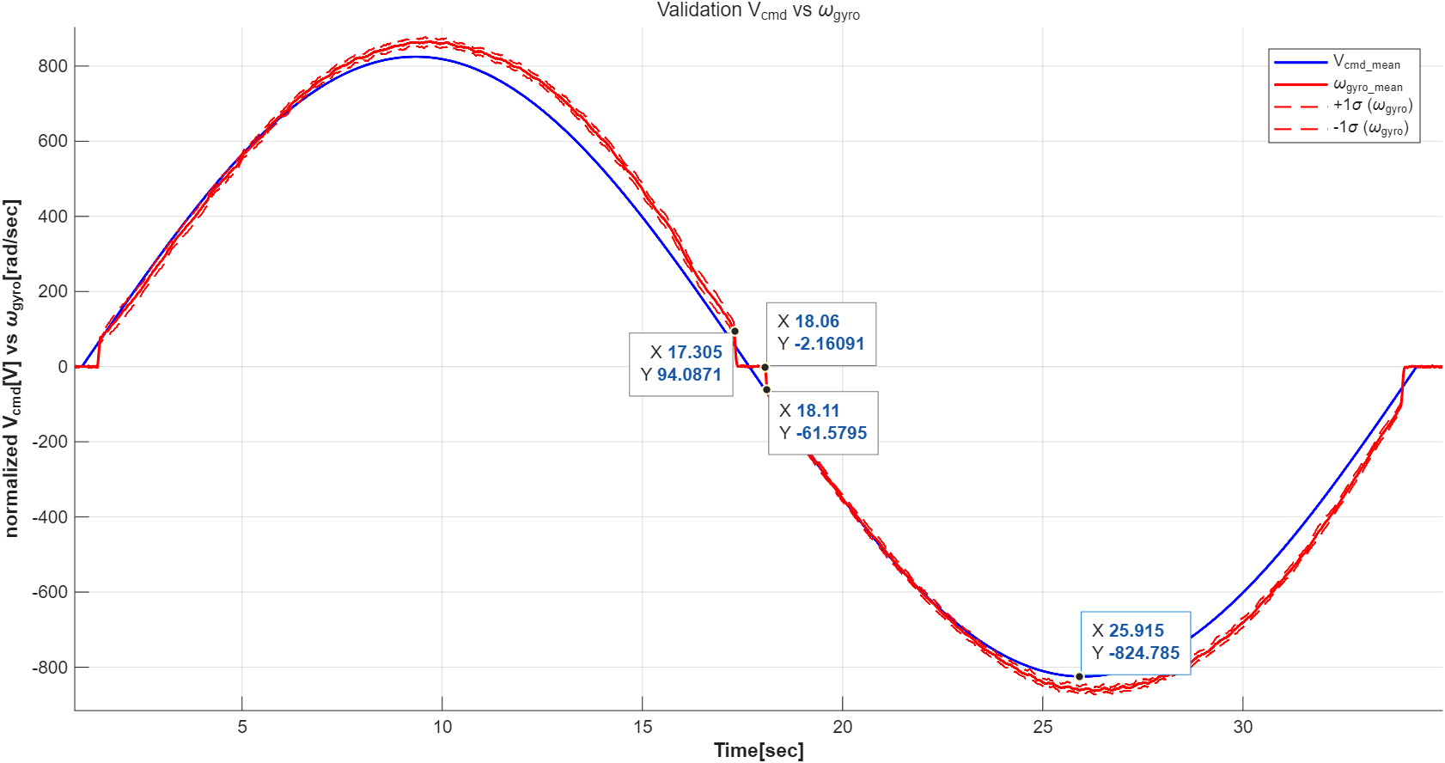
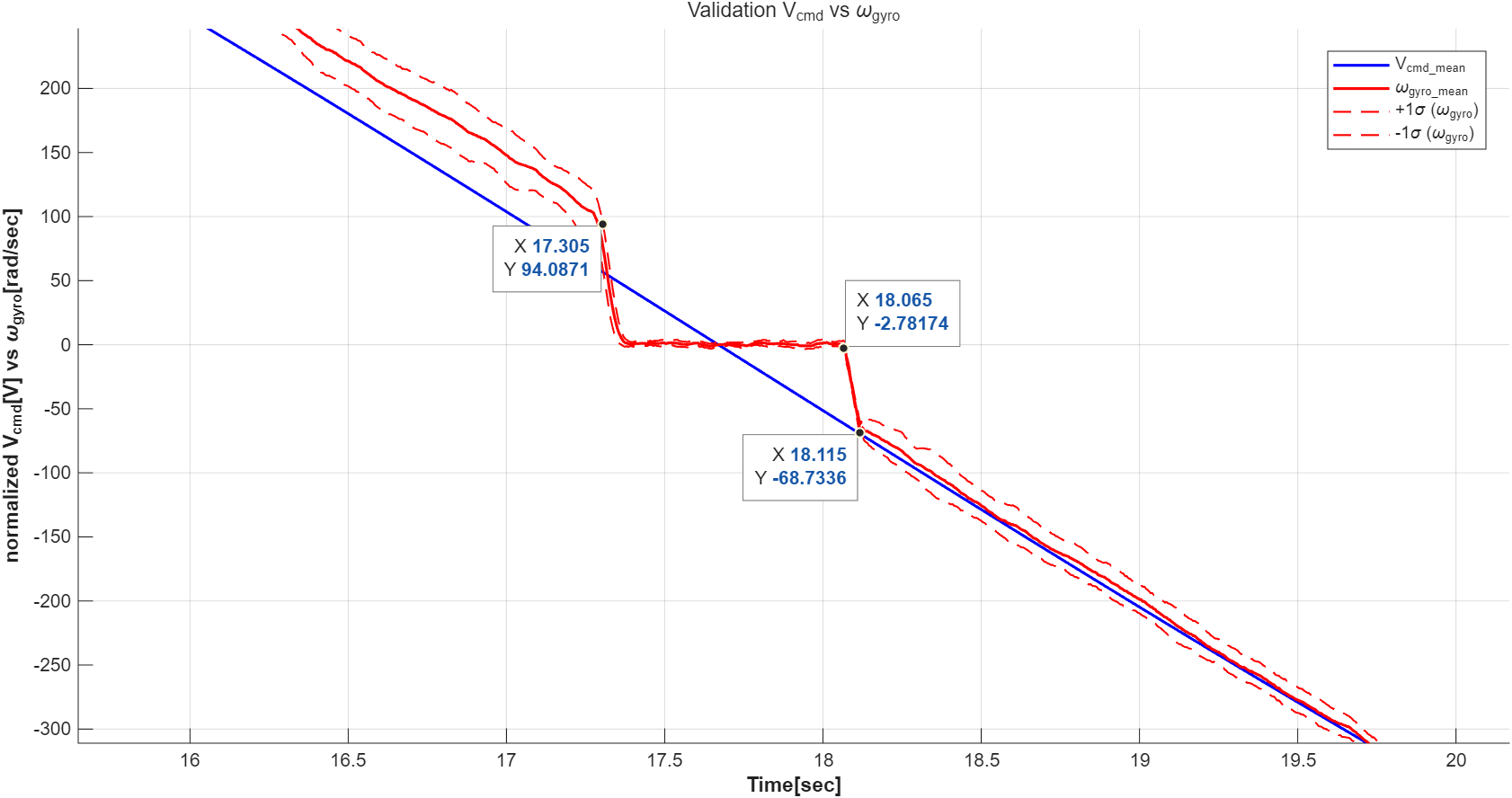
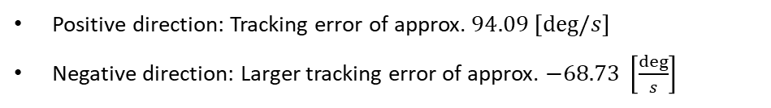
3. Motor Linearization Validation
1) Sin input
Positive direction: Tracking error of approx. $94.09 [deg/s]$
Negative direction: Larger tracking error of approx. $−68.73 \left[\frac{deg}{s}\right]$

Slide 12
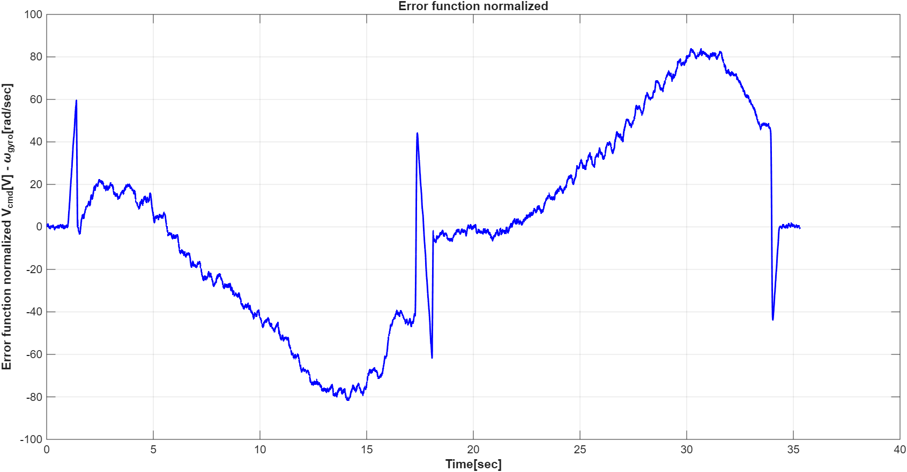
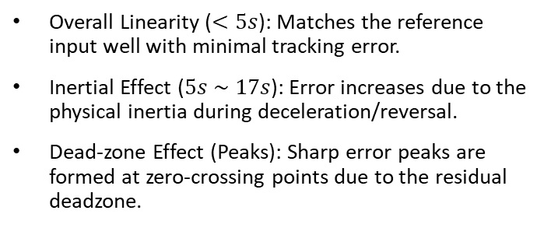
3. Motor Linearization Validation
1) Sin input
Overall Linearity ($<5s$): Matches the reference input well with minimal tracking error.
Inertial Effect ($5s \sim 17s$): Error increases due to the physical inertia during deceleration/reversal.
Dead-zone Effect (Peaks): Sharp error peaks are formed at zero-crossing points due to the residual deadzone.

Slide 13
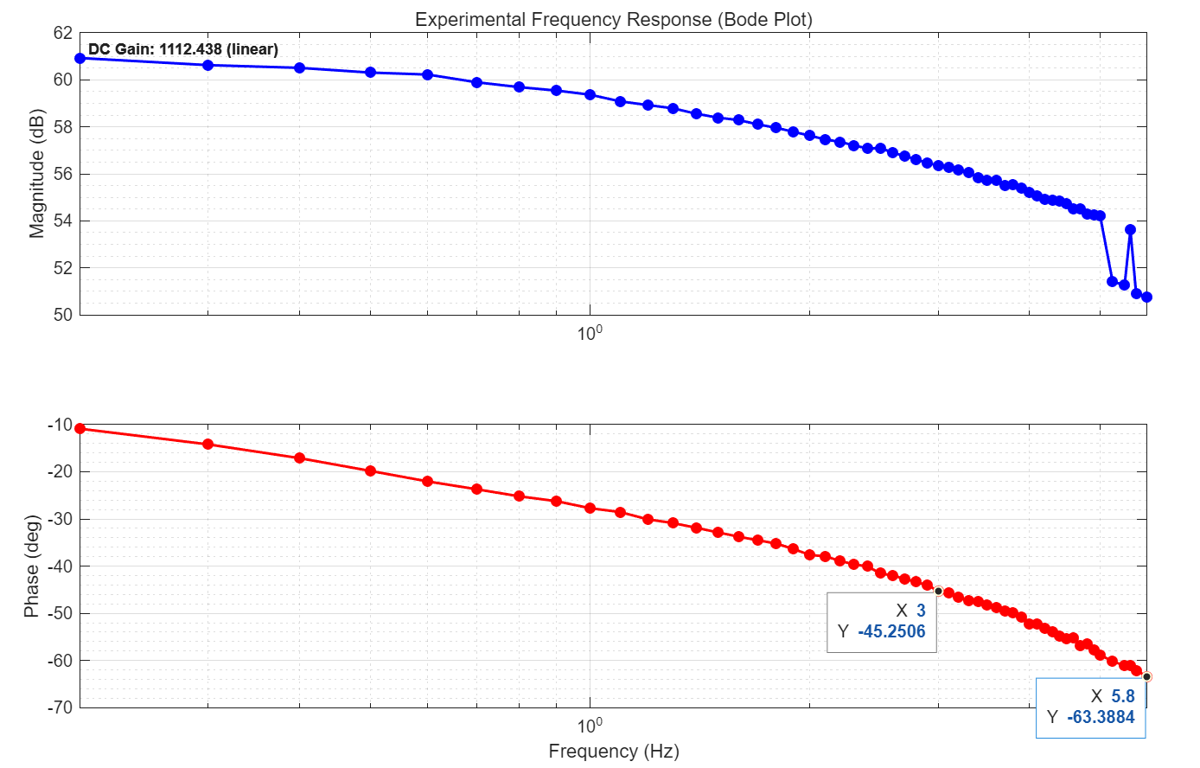
3. Obtaining Transfer Function & Validation
Obtaining freq_responses of Motor
Range of Check: 0.2 – 5.8 [Hz]
Bandwidth: ~ 3.0 [Hz]
System_order: 1st
DC_gain: ~ 1112.43 [deg/sec]

Slide 14
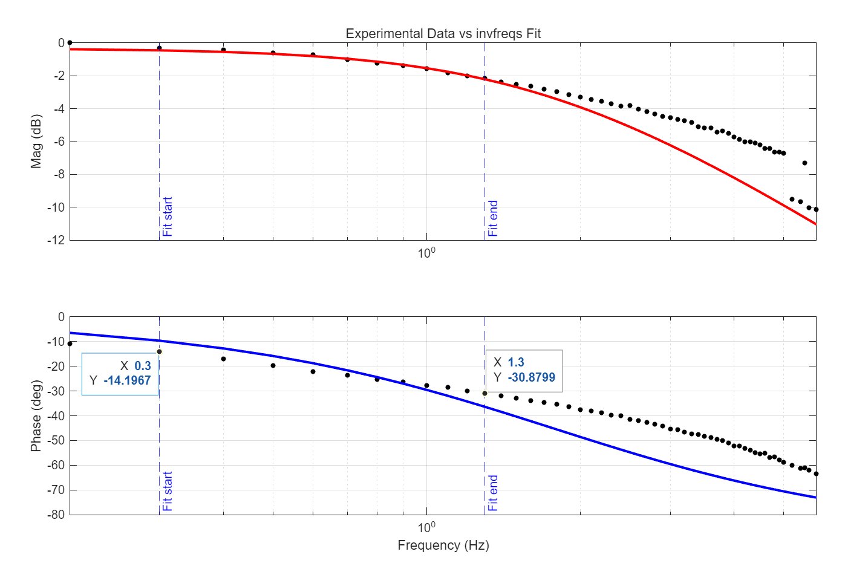


4. Obtaining Transfer Function & Validation
Obtaining Transfer function of Motor
$$G\left(s\right)=K∗G_{c}\left(s\right)$$
$$G\left(s\right)=1112.4385∗\frac{10.6798}{s +11.0963}$$
Fitted_range: 0.3 – 1.3 [Hz]

Slide 15
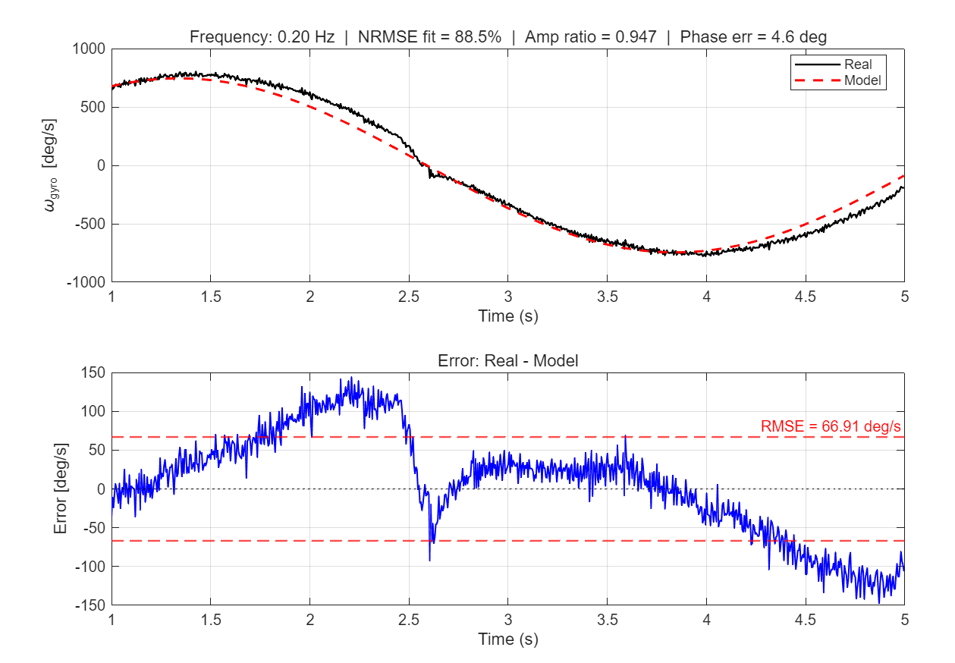
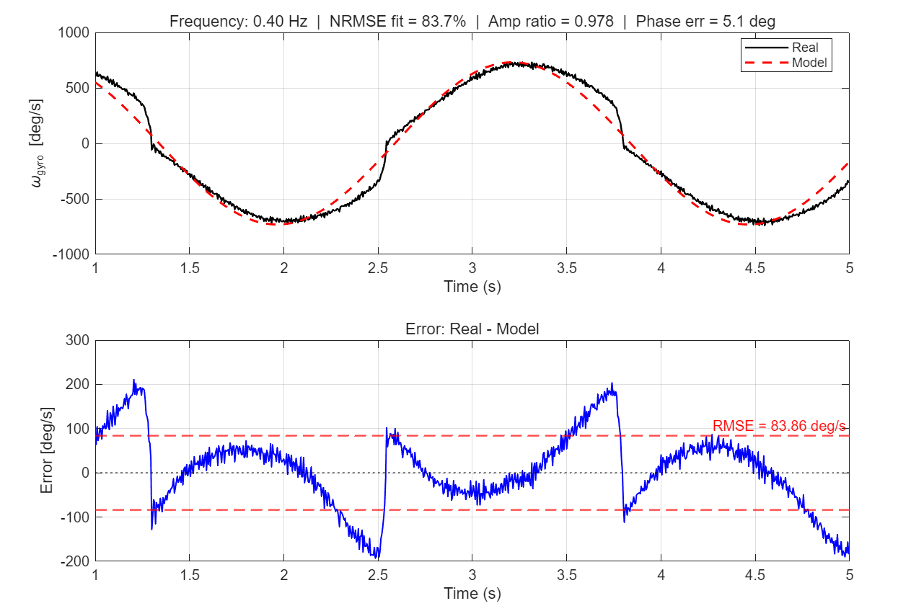
6. Motor Validation
Representative Frequencies:

Slide 16
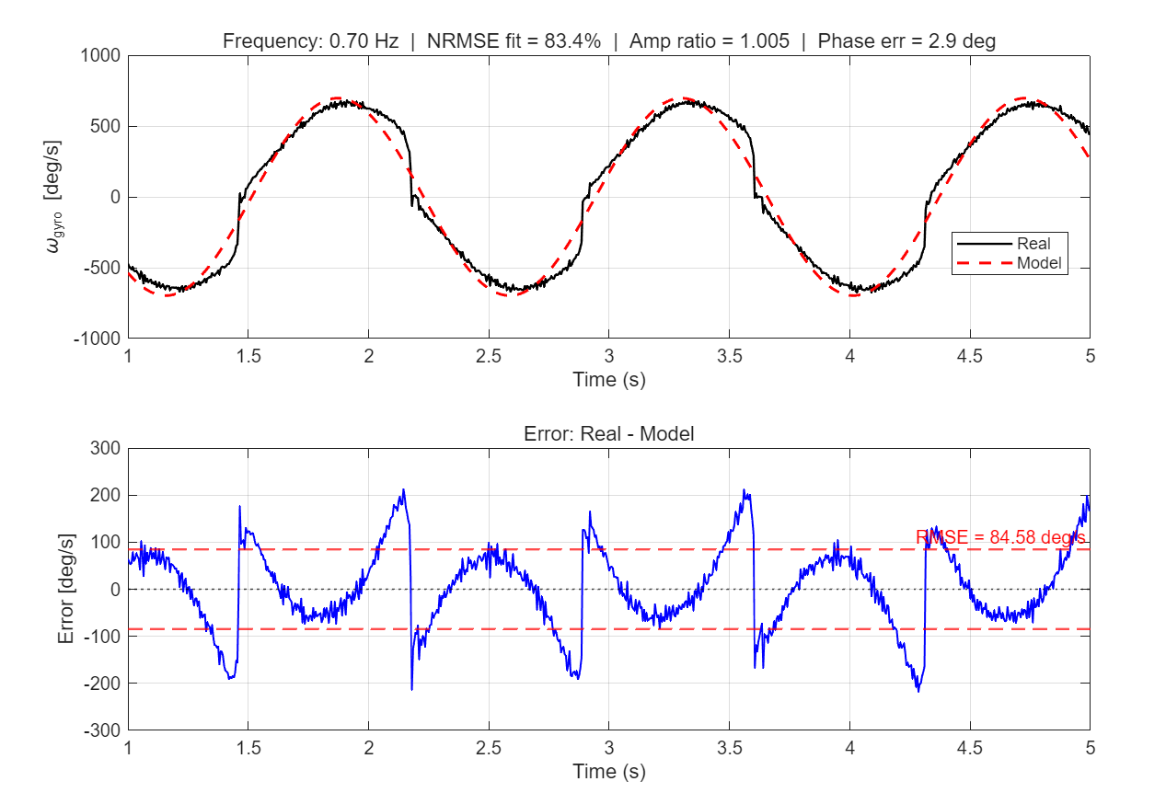
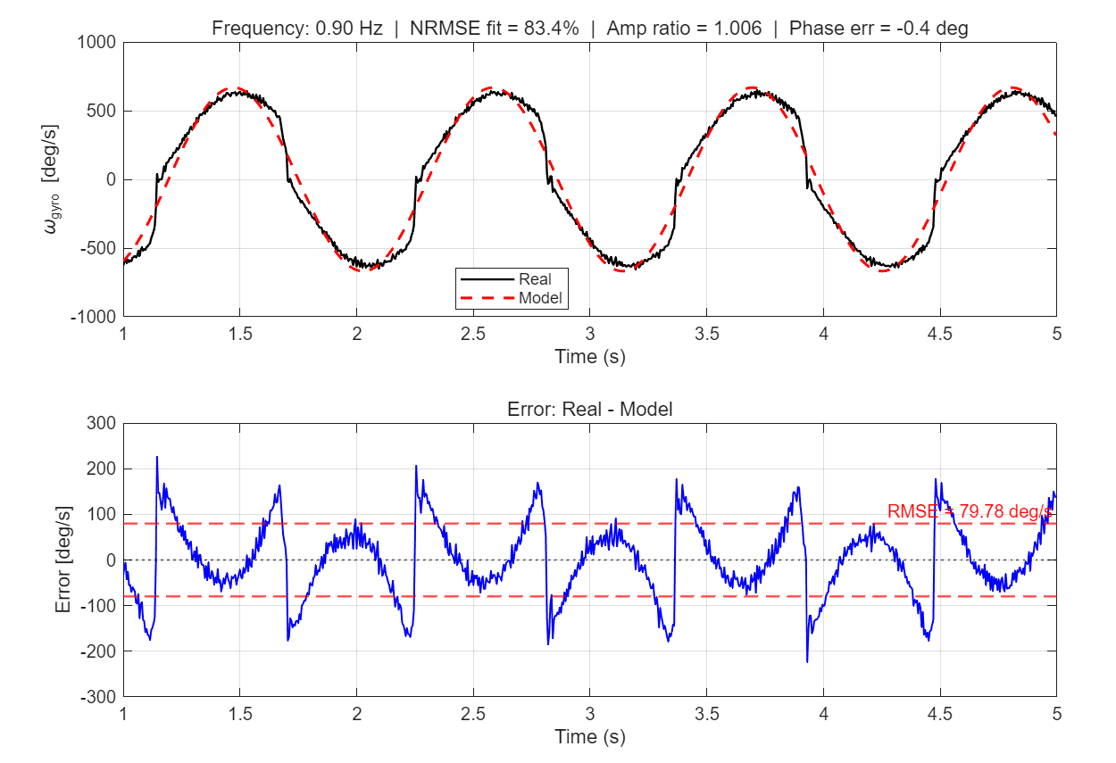
6. Motor Validation
Representative Frequencies:

Slide 17
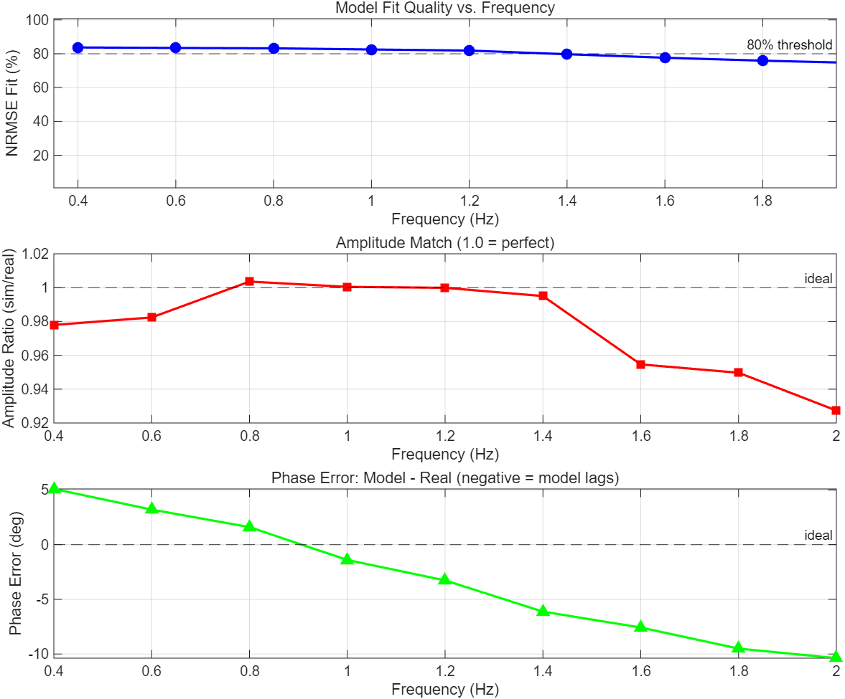
6-1. Visualizing Errors
RMS fit: ~ 80 % following
Magnitude fit: ~ 90 %
Phase Error: Needs to be talked.

Slide 18
6-1. Visualizing Errors
RMS fit: ~ 80 % following
Magnitude fit: ~ 90 %
Phase Error: Needs to be talked.
The leading terms in low frequency
Inertia is detected
Jump discontinuity in neg region
Deadzone & Backlash movement.

Slide 19
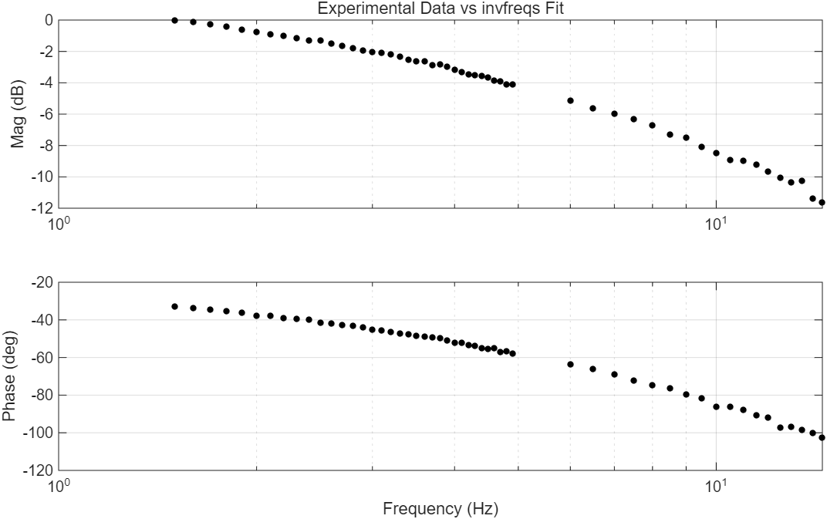
Appendix
invFreq(1,2):

Slide 20
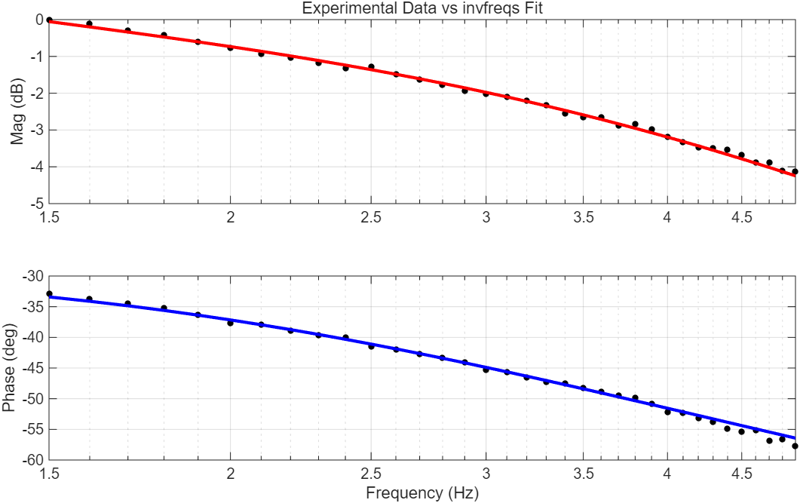
Appendix
invFreq(1,2):

Slide 21
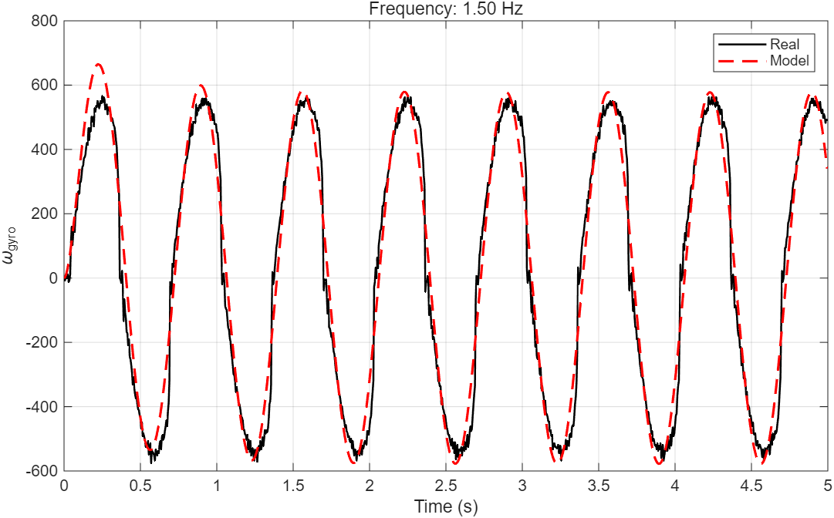
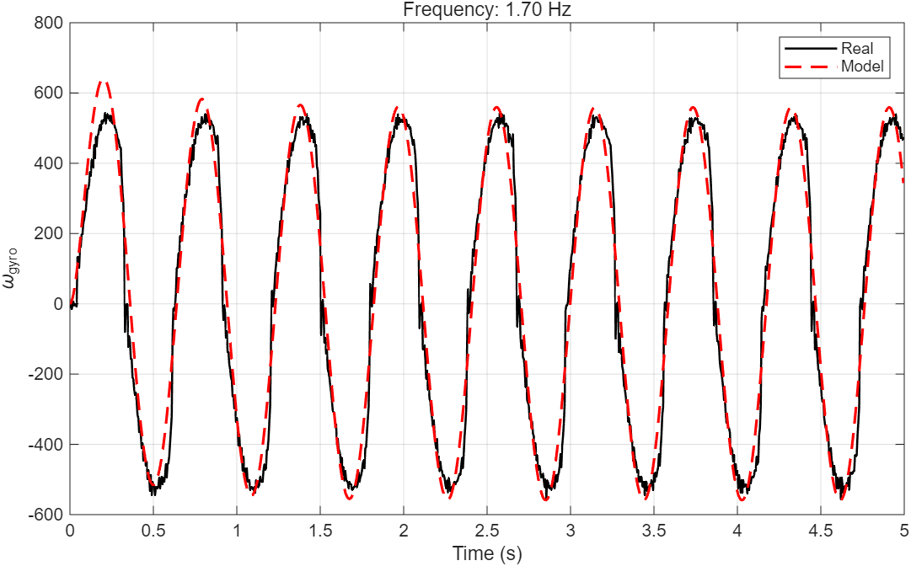
Appendix
invFreq(1,2):

Slide 22
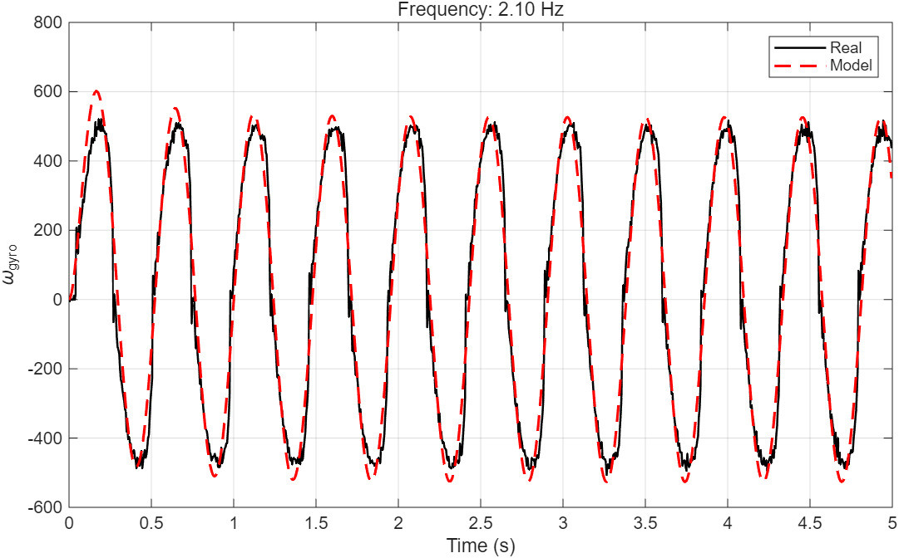
Appendix
invFreq(1,2):

